Slide 1


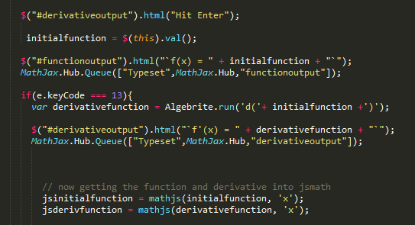
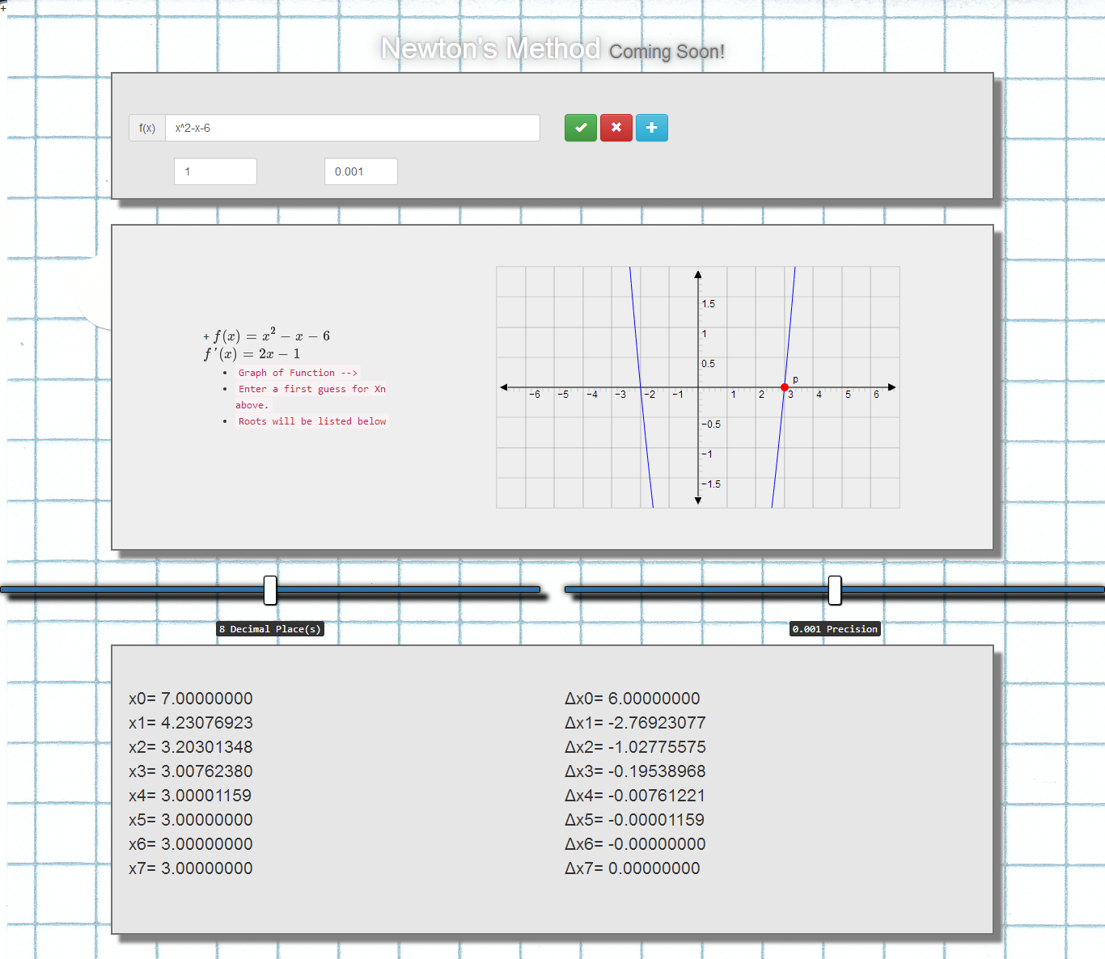
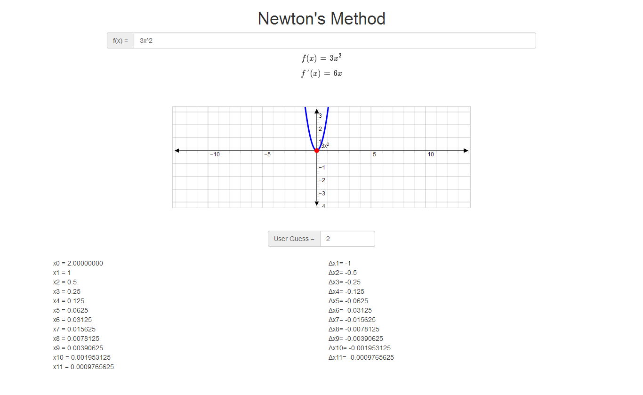
Newton's Method Calculator John Redden, Rachel Owens, Cory Lewis
¹College of the Sequoias, & California State University, Fresno
²College of the Sequoias & California State Polytechnic University, Pomona
³Natural Resources Conservation Service, United States Department of Agriculture
Introduction
Design
Calculations
In numerical analysis, Newton's method (also known as the Newton–Raphson method), named after Isaac Newton and Joseph Raphson, is a method for finding successively better approximations to the roots (or zeroes) of a real-valued function.
Survey
Prototype
Proposed Designs
Objectives
Version 1
A blend of the concepts from the prototype and concepts from the final piece..
Take one function and take its derivative
Graph the function
Use f(x) and f’(x) to apply newton’s method
Get Critical value
History
Newton's method was first published in 1685 in A Treatise of Algebra both Historical and Practical by John Wallis. In 1690, Joseph Raphson published a simplified description in Analysis aequationum universalis. Raphson again viewed Newton's method purely as an algebraic method and restricted its use to polynomials, but he describes the method in terms of the successive approximations xn instead of the more complicated sequence of polynomials used by Newton. Finally, in 1740, Thomas Simpson described Newton's method as an iterative method for solving general nonlinear equations using calculus, essentially giving the description above. In the same publication, Simpson also gives the generalization to systems of two equations and notes that Newton's method can be used for solving optimization problems by setting the gradient to zero.
Required Design Components
Before Doing all calculations for newton’s method there are a few required javascript plugins to make the app complete.
Bootstrap cdn (Used for Styling)
MathJax cdn (converts f(x) into Javascript math)
Algebrite ( Takes derivative of Javascript math)
JSXGraph (Graphs f(x))
Jquery (simpler version of javascript)
Faster More Efficient
Shows typed function live below input box. When ENTER is pressed the graph fades in allowing the user to enter a first guess and see which critical value was found.
Acknowledgements
Special thanks to: The SURGE Program, John Redden, Dr. Lawrence Owens, Duane Goodwin.
Funding for this project was provided by the College of the Sequoias SURGE program, which is funded by the US Department of Education MSEIP grant #P120A130106.

